Slide 1
I/O (Input/Output)

Slide 2
Common Forms of Input
User-typed input
Reading from a file
Command-line arguments

Slide 3
Common Forms of Output
Printing to the console
Writing to a file

Slide 4
Input/Output
Both input and output in Java work with a "stream" which accesses the buffer (memory).
InputStream reads data from the buffer, i.e. System.in
OutputStream writes data from the buffer into files or the console, i.e. System.out

Slide 5
Used-Typed Input
Java's Scanner class can help retrieve user-typed input
It takes the InputStream as a parameter
It then parses/converts the data stream into the specified type (i.e. int, double, etc.)

Slide 6
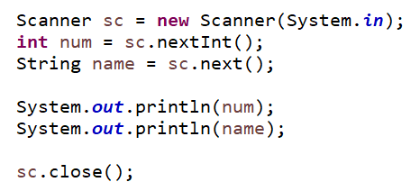
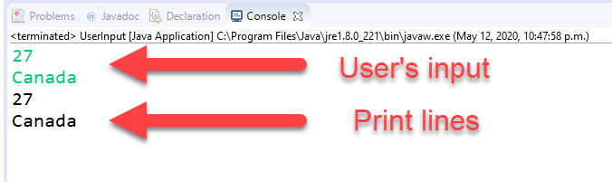
Used-Typed Input

Slide 7
File Input
Java's BufferedReader class is similar to Scanner but works better for file input.
The FileReader class works closely with BufferedReader to open a file that can then be parsed and read in.
File input could also be done with other input stream classes (as shown in ZyBooks).

Slide 8
File Input
The files to read must be in the area in which the .classpath file is located.
This will normally be the root folder, not within src or bin.

Slide 9
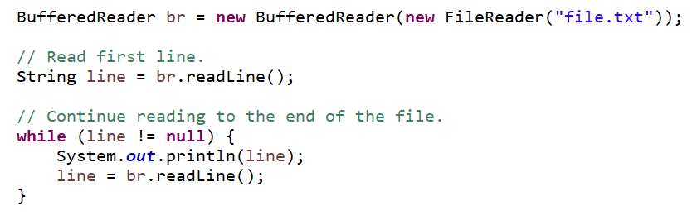
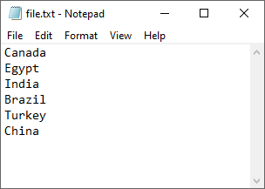
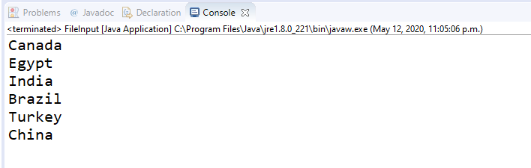
File Input

Slide 10
Arguments
Have you wondered what the parameter "String[] args" in the main method is used for?
These are called command-line arguments and are fed into the main method when you run it.
They are useful for simulations or programs in which one of several data/map files needs to be loaded.

Slide 11
Arguments
The args come in a String array so you can have as many or few as you need.
Use conditionals to check how many args are coming in. i.e.
if (args.length == 1) { new MySimulation(args[0]); } else { System.out.print("No args provided"); }

Slide 12
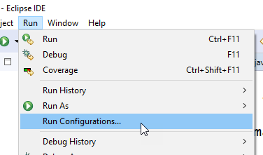
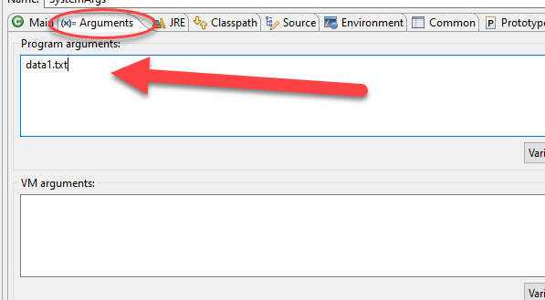
Arguments
Where do we set these arguments in Eclipse?

Slide 13
Output to Console
System.out.print() or .println() are used to print data to the console
The methods are overloaded, meaning they can take in variables of any kind
System.out.print(192);
System.out.print(45.7);
System.out.print("Hello");

Slide 14
Output to Console
Eclipse has a shortcut for this. Type "sysout" and hit Ctrl+Space. Note: I don't know if this works on all platforms (i.e. Macs) or just on Windows.
You can also format or "pretty print" the data to the console. This topic is well-explained in the zyBooks reading (Section 9.2) so I won't cover it here.

Slide 15
File Output
Just like file input (reading), there are built-in data stream classes for file output (writing to a file).
BufferedWriter and FileWriter are used together to create or open a file and write to it.
If the file already exists, you can either write (overwrite the existing content) or append (add content to the bottom).

Slide 16
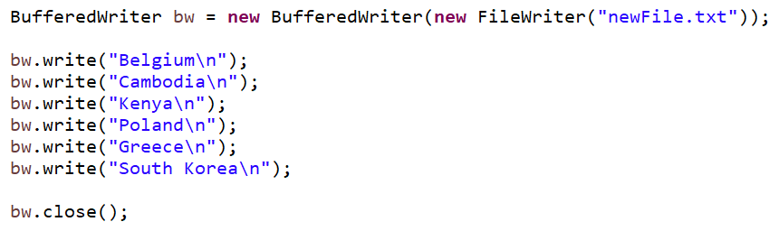
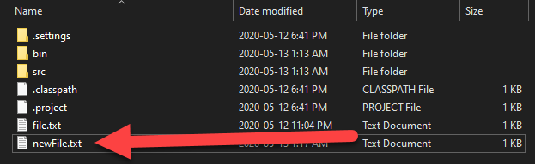
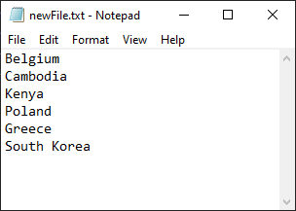
File Output

